Slide 1
The Registration Agency, DDI and Linked Open Data
EDDI 2011
Nicole Quitzsch, Erdal Baran
GESIS – Leibniz Institute for the Social Sciences

Slide 2
History of the GESIS-Archive
Over 50 years
DBK = Data Catalogue of the Archive
DBK schema was developed long before DDI → DDI compatible

Slide 3
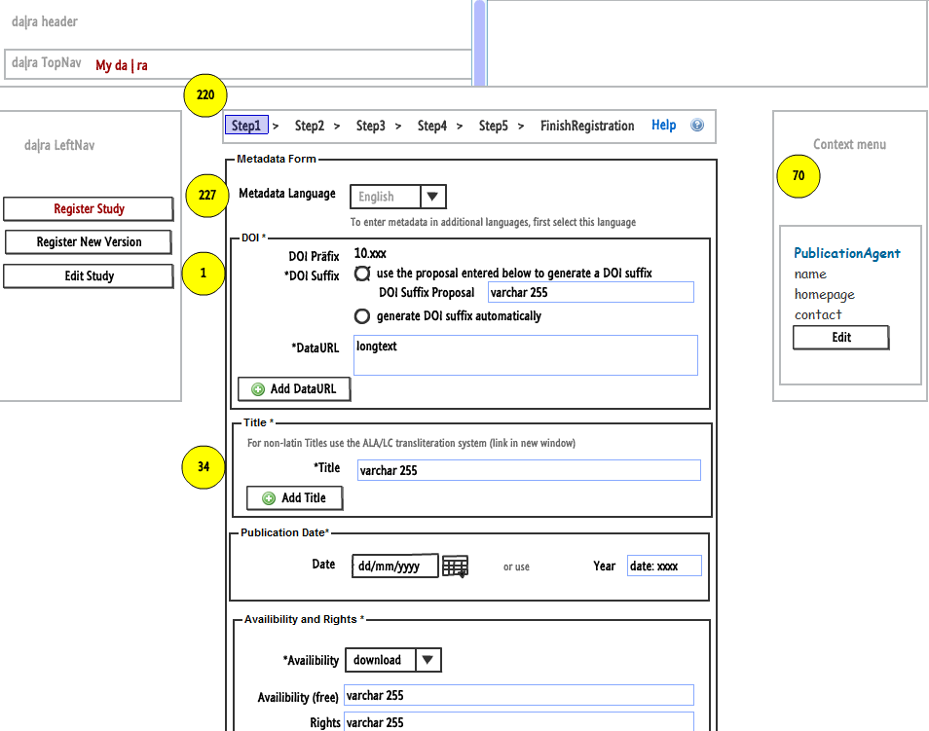
Future

Slide 4
Simplicity
Da|ra is member of DataCite
Da|ra and DataCite oriented to DDI and contained suggestions from DDI
Da|ra important elements from DDI and integrated them into our metadata schema

Slide 5
Mapping
Data sets of independent, heterogeneous systems must be mapped to a common data format
Mapping only works if metadata formats are interoperable

Slide 6
Mapping da|ra 2.2 to DDI 3.1
Da|ra mandatory properties:
Da|ra 2.2 | Mapping to DDI 3.1
1 Title | Title Subtitle AlternateTitle AlternateTitle translated
3 Principal Investigator | Creator
4 Publication Agent | Publisher
5 Registration Agency | Role=“Registration Agency“
6 DOI | InternationalIdentifier type=“DOI“ or UserID type=“DOI“
7 URL | URL
11 Publication Date | Simple Date
32 Availability (contr.) | AccessConditions

Slide 7

Mapping Problems
Information Lost

Slide 8
Mapping problems
Da|ra 2.2 | DDI 3.1
Classification | Subject
Number of Units | Case Quantity
Person ID | ResearcherID Identifier
Availability | Access Conditions
Principal Investigator | Creator

Slide 9
Metadata interoperability
  DDI 3.1 can hold da|ra mandatory metadata properties
  Da|ra 2.2 metadata schema is compliant with the DDI 3.1 standard

Slide 10



Conclusion

Slide 11
What is Linked Open Data (LOD)?
  Linked Data Principles*
    Use URIs as names for things
    Use HTTP URIs so that people can look up those names
    When someone looks up a URI, provide useful information, using the standards (RDF*,SPARQL)
    Include links to other URIs, so that they can discover more (related) things
  Open Data refers to the legal usage of data
  * [Tim Berners-Lee 2007, http://www.w3.org/DesignIssues/LinkedData.html]

Slide 12
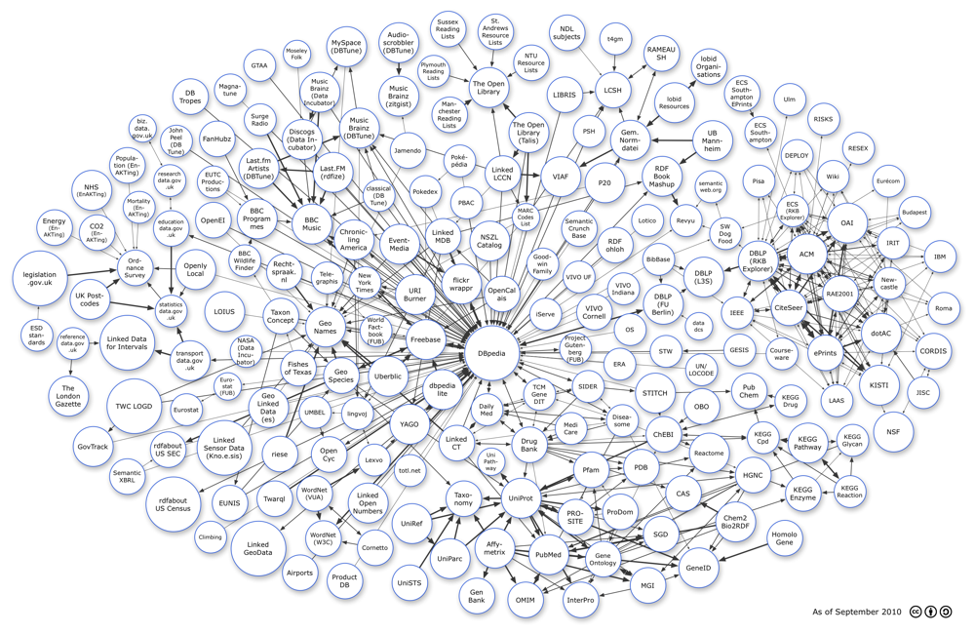
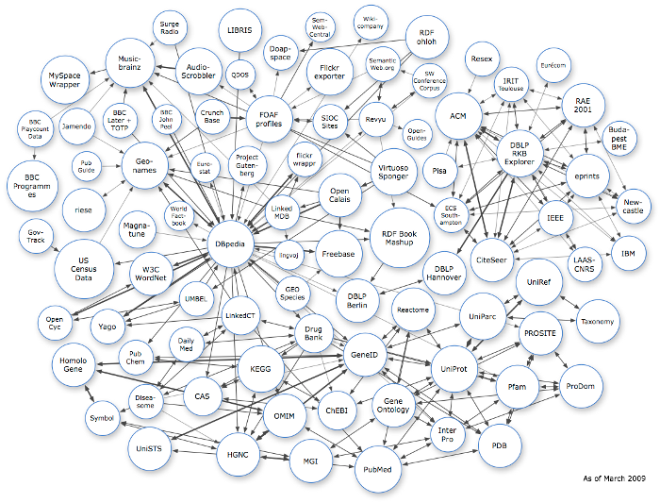

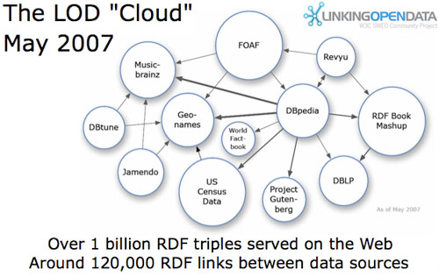
Development of Linked Open Data

Slide 13

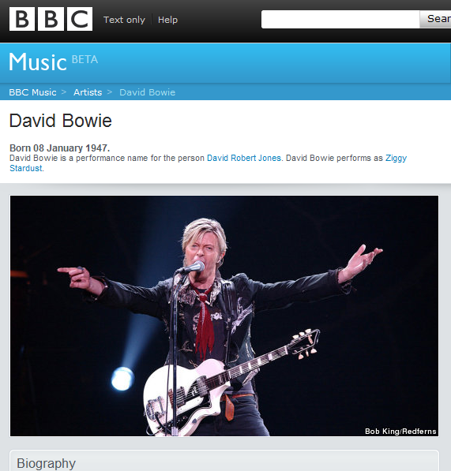
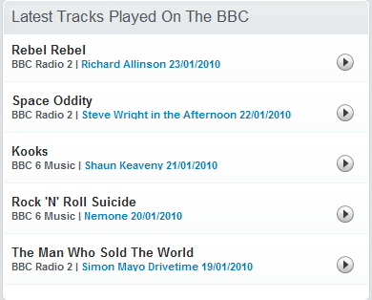
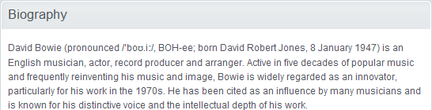

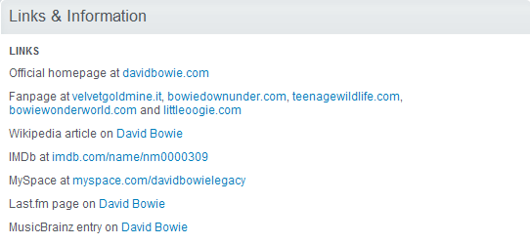

Linked Open Data by BBC
sameAs

Slide 14
Motivation
Value of data increases the more it is interlinked with other data
  RDF to structure the data
  HTTP URIs to publish
  Semantic references such as owl:sameAs to semantically associate and link
LOD Benefits:
  By following the links, humans can browse, search engines can crawl
  Query expansion capabilities over distributed data

Slide 15
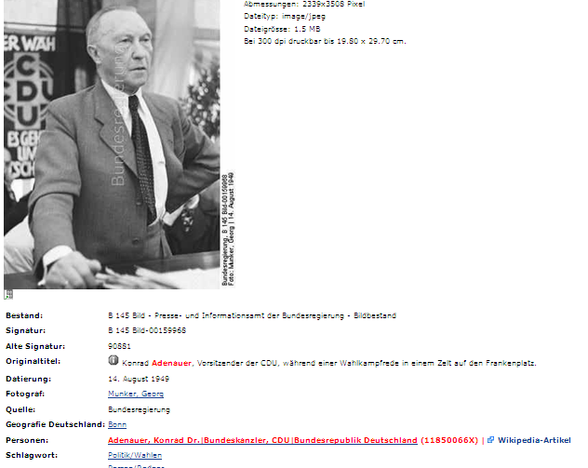
Usage of the „Crowd Sourcing“

Slide 16

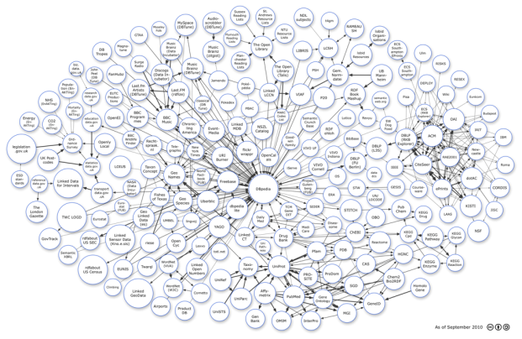
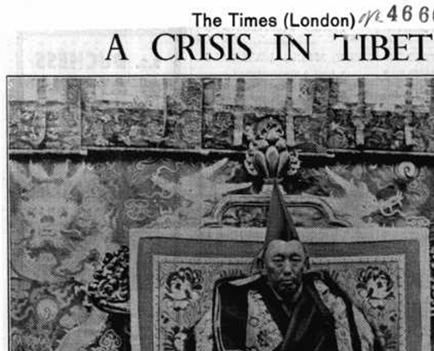
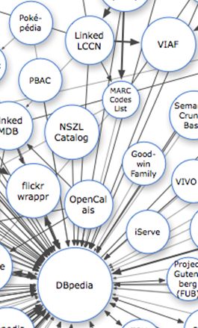




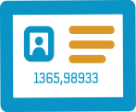




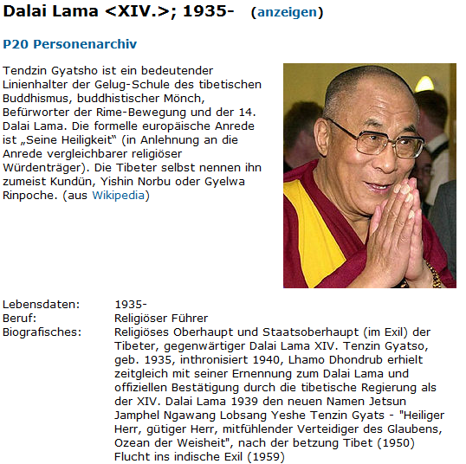
Connection between da|ra and Web
Dalai Lama

Slide 17

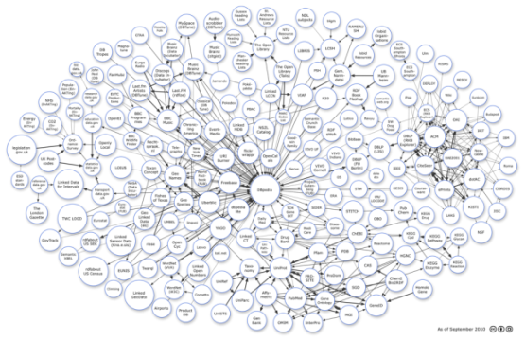



Connection between da|ra and Web
Thomas Bosch – Reusing XML Schemas‘ Information as a Foundation for Designing Domain Ontologies
Working Group - Semantic Statistics

Slide 18
Thank you for your attention!
Nicole Quitzsch GESIS–Leibniz-Institute for the Social Sciences nicole.quitzsch@gesis.org
Erdal Baran GESIS–Leibniz-Institute for the Social Sciences erdal.baran@gesis.org
For further information visit: http://www.gesis.org/dara

